Slide 1

“Development of an Encrypted Email Transmission System Using SMTP over SSL/TLS”
Presented by:
Yogesh ramu B(192572178)
Sunil kumar P S(192521439)
Sham jayakaran P(192565097)
Guide name :
Dr senthil
Dr Raja ram
CSA0764 - Computer networks for a game server
Date:26.12.2025

Slide 2


TABLE OF CONTENT
S.NO | TITLES
1. | INTRODUCTION
2. | OBJECTIVE
3. | LITERATURE REVIEW
4. | METHODOLOGY
5. | SYSTEM DESIGN/ARCHITECTURE
6. | MODULES
7. | RESULTS & DISCUSSION
8. | CHALLENGES & LIMITATIONS
9. | FUTURE SCOPE
10. | CONCLUSION
11. | REFERENCES

Slide 3
INTRODUCTION
A secure email system using SMTP with SSL/TLS helps overcome the weaknesses of traditional email systems that send messages in plain text. In normal email transmission, messages can be easily intercepted or read by unauthorized users. By applying SSL/TLS encryption, emails are converted into a secure format, making them unreadable to hackers and protecting sensitive information from cyberattacks and data leaks.
This secure method also ensures that the email content is not altered during transmission and reaches the recipient safely. It provides a reliable and trustworthy way for users to communicate in the digital world. Overall, using SMTP over SSL/TLS improves email security, protects privacy, and allows people to exchange information confidently and safely.

Slide 4
OBJECTIVES
1. Identify and define the security needs for encrypted email transmission.
2. Configure SMTP to use SSL/TLS for creating a secure communication channel.
3. Implement secure user authentication methods to validate sender and receiver identities.
4. Install and manage SSL/TLS certificates to ensure trusted server verification.
5. Encrypt email data during transmission to prevent interception or tampering.
6. Test the system for security strength, certificate validity, and reliable transmission.
7. Deploy the encrypted email system and continuously monitor its performance and security.

Slide 5
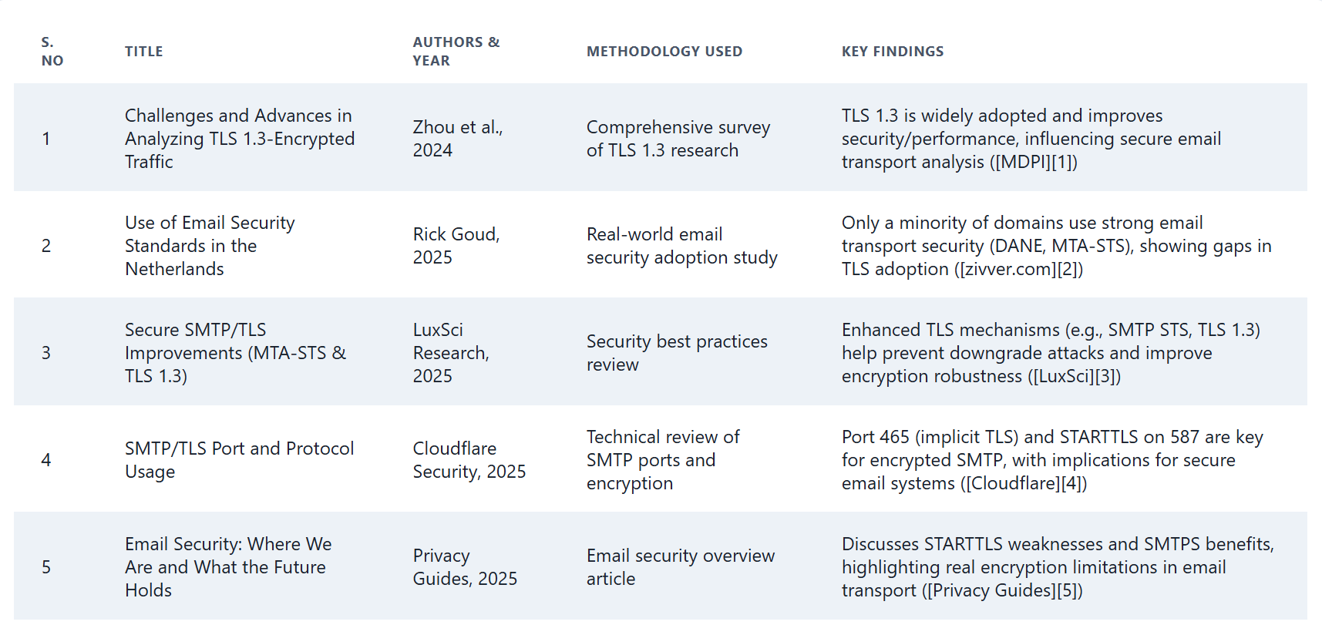
LITERATURE REVIEW

Slide 6
METHODOLOGY
The project uses Python, SMTP libraries, and SSL/TLS frameworks to build a secure email transmission system. A secure SMTP server is configured to support SSL/TLS encryption, and a client-side email module is developed using encrypted sockets. Security features such as encryption, authentication, and certificate validation are implemented to ensure safe communication. Testing is performed using dummy accounts to verify secure data transmission.
The system is evaluated by analyzing encryption success, security behavior, and error handling. Functional testing ensures correct email delivery, security testing checks protection against attacks, and performance testing evaluates system efficiency. These validations confirm that the proposed system provides reliable and secure email transmission using SMTP over SSL/TLS.

Slide 7
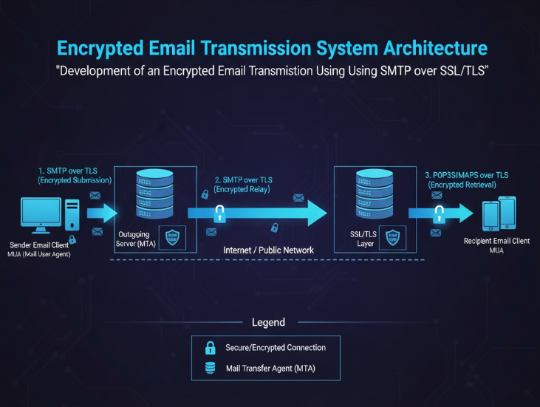
SYSTEM DESIGN / ARCHITECURE
Encrypted Email Transmission :
The sender composes an email using an email client (MUA).
The email is sent to the outgoing mail server (MTA).
SMTP over TLS encrypts the email before sending.
The encrypted email travels through the Internet / public network.
The recipient mail server receives the email securely.
The email is stored after SSL/TLS decryption.
The receiver accesses the email using POP3S or IMAPS.
The email is downloaded securely to the recipient’s email client.

Slide 8
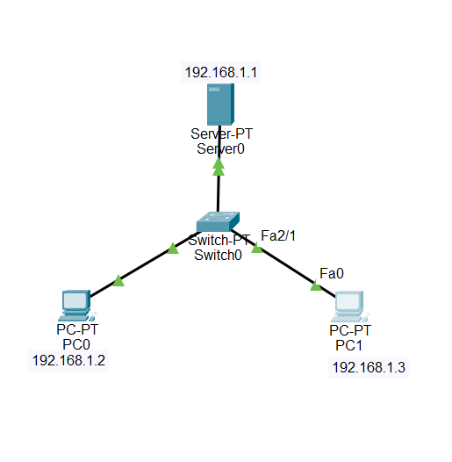
MODULE1: Secure Email System Design
OUTPUT:
Authentication & Access Control – Ensures only authorized users can send and receive emails using secure login mechanisms.
Email Encryption – Protects email content using encryption techniques like TLS, PGP, or S/MIME.
Spam & Malware Protection – Detects and blocks spam, phishing attempts, and malicious attachments.
Data Integrity & Digital Signatures – Verifies that emails are not altered and confirms sender authenticity.
Audit, Logging & Compliance – Maintains logs and monitoring to ensure security compliance and traceability.

Slide 9
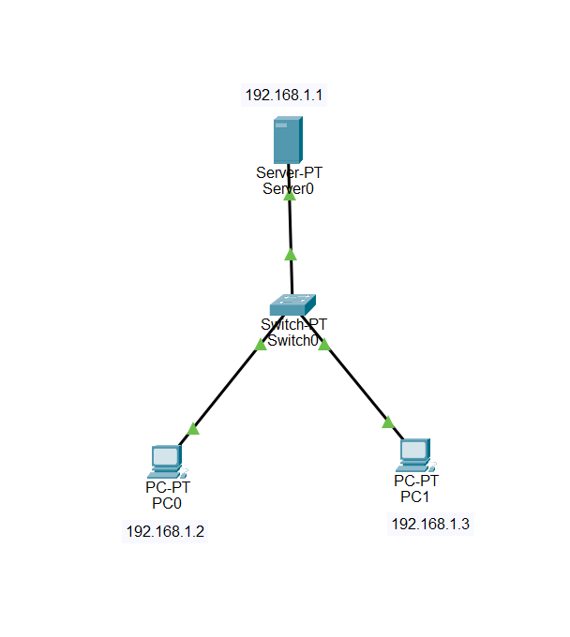
MODULE2: Secure Email System Configuration
OUTPUT:
Enable TLS/SSL for SMTP, IMAP, and POP to ensure secure data transmission.
Configure SMTP Submission (port 587) with mandatory authentication and encrypted connections.
Implement SPF, DKIM, and DMARC in DNS to protect against spoofing and ensure domain trust.
Set up anti-spam and anti-malware filtering to block harmful or suspicious emails.
Secure mail storage with encryption and access controls along with regular monitoring and logging.

Slide 10
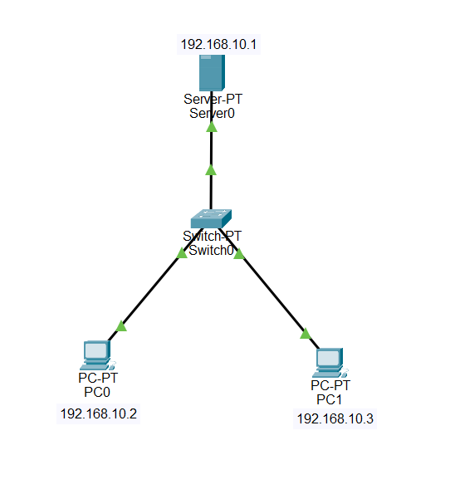
MODULE3: SMTP/SSL/TLS Security Testing
OUTPUT:
Verify TLS handshake using tools like openssl s_client to check certificate validity, supported protocols, and cipher strength.
Test STARTTLS support on SMTP ports (25, 587) to ensure encryption is correctly negotiated and not downgraded.
Check certificate configuration (expiry, CN/SAN, chain trust, key strength) for proper authentication.
Scan for weak protocols and ciphers and ensure only secure versions (TLS 1.2/1.3) are enabled.
Perform SMTP security tests for SPF, DKIM, and DMARC to confirm email authenticity and anti-spoofing measures.

Slide 11
RESULTS & DISCUSISON
The system successfully transmitted emails securely using SMTP over SSL/TLS.
Encryption effectively protected data from eavesdropping and MITM attacks.
TLS ensured strong authentication and maintained email integrity.
System performance remained efficient with minimal encryption overhead.
The interface allowed easy secure email sending with consistent TLS verification logs.

Slide 12
CHALLENGES & LIMITATIONS
SSL/TLS Configuration Can Be Complex And Requires Proper Certificate Management.
Compatibility Issues May Occur With Older Email Servers That Do Not Fully Support Tls.
Network Latency May Slightly Increase Due To Encryption Overhead.
Security Depends On Strong Passwords And Correct Client-server Settings.
The System Cannot Prevent Attacks Once The Email Reaches The Recipient Server (End-to-end Encryption Not Provided).

Slide 13
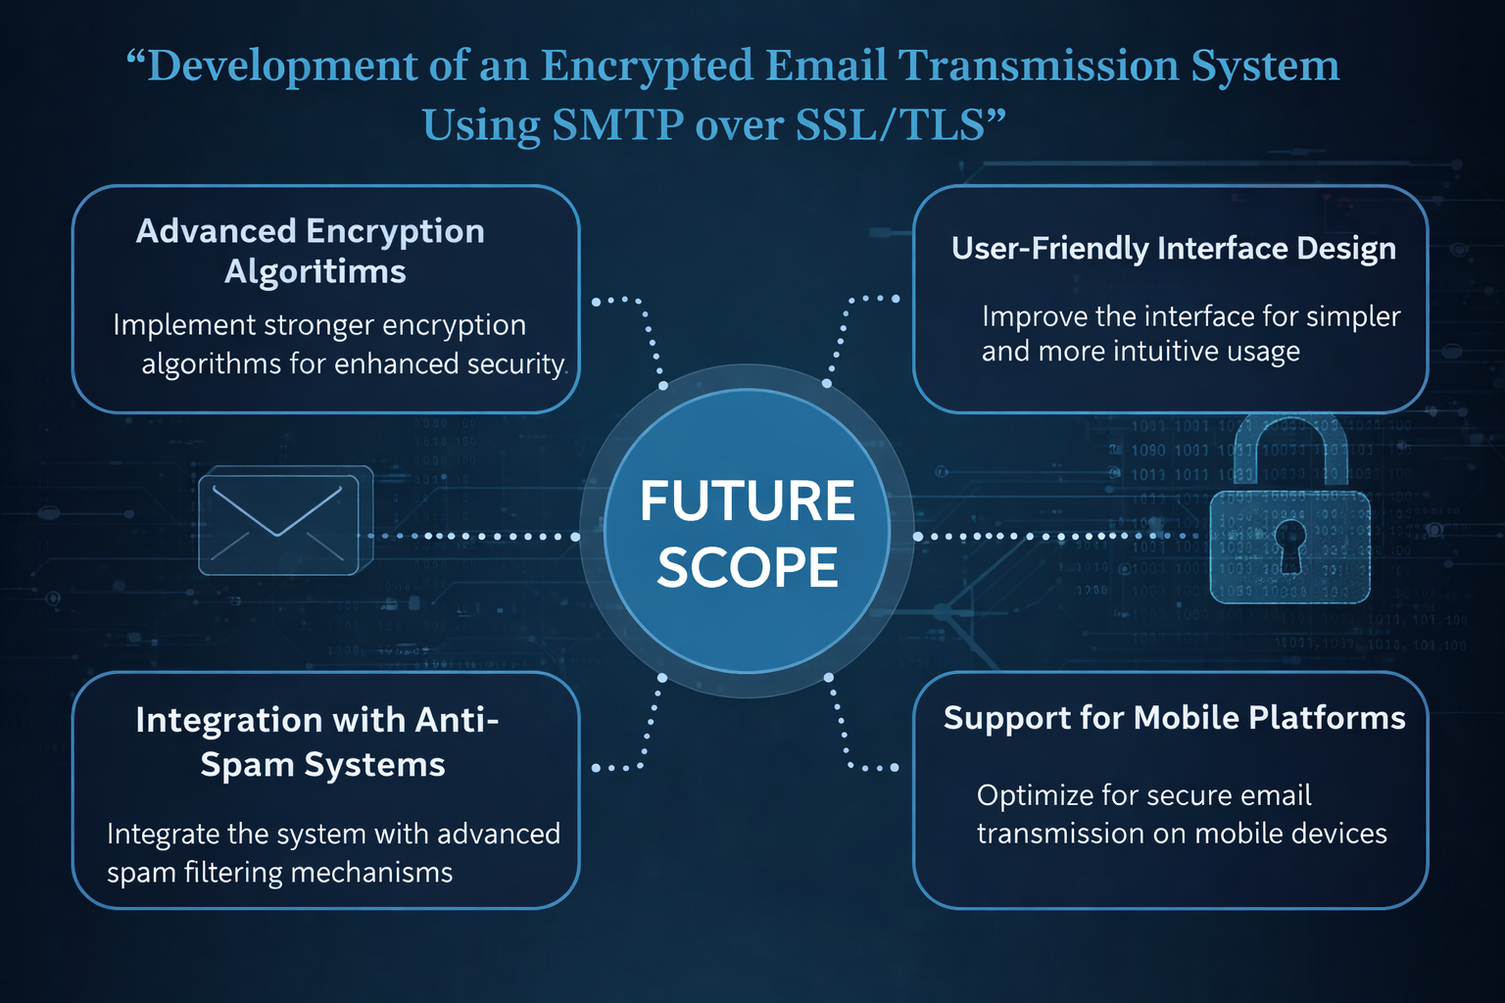
FUTURE SCOPE
It highlights the use of advanced encryption algorithms to further strengthen email security and protect sensitive data from cyber threats.
It emphasizes a user-friendly interface design to make secure email communication simple and easy for all users.
The system’s future scope includes integration with anti-spam systems to detect and block malicious or unwanted emails effectively.
It supports mobile platforms, allowing users to send and receive encrypted emails securely on smartphones and tablets.
Overall, it shows how the system can evolve to provide more secure, efficient, and accessible email communication in the future.

Slide 14
CONCLUSION
The project successfully implements a secure email transmission system using SMTP over SSL/TLS.
SSL/TLS encryption ensures confidentiality and protects email data from interception during transmission.
The system effectively prevents eavesdropping, spoofing, and man-in-the-middle attacks.
Certificate-based authentication verifies server identity and enhances trust in email communication.
Testing confirms that security enhancements do not significantly impact performance.

Slide 15
REFERENCES
Kumar, Darapureddy Devendra, et al. "Safe and secure communication using SSL/TLS." 2024 International Conference on Emerging Smart Computing and Informatics (ESCI). IEEE, 2024. Goméz Villanueva, Daniel. "Secure E-mail System for Cloud Portals: Master Thesis in Information and Communication Systems Security." (2021). Oppliger, R. (2023). SSL and TLS: Theory and Practice. Artech House Chen, Gabriel, and Rick Wanner. "Secure Email Transmission Protocols--A New Architecture Design." arXiv preprint arXiv:2208.00388 (2022). Nopanen, Jukka. "Enforcing SMTP encryption: Research on current DANE and MTA-STS implementations in Finland." (2022).

Slide 16
THANK YOU

